Slide 1
COVID -19: Labour Market Outcomes & Sectoral Analysis
Nov 23, 2021
Dr. Vik Singh
Global Management Studies
Ted Rogers School of Management
Ryerson University
Email: vik.singh@ryerson.ca
Presentation: CivicLabTO Academic Summit

Slide 2
Background
Study funded by City of Toronto and MITACS
Data for sector analysis: Canadian Labour Force Survey (CLFS), Canadian Perspective Survey Series (CPSS) and the Canadian Survey on Business Conditions (CSBC) from Statistics Canada.
Probit Model
Impulse Response Model (IRF)

Slide 3
COVID-19 Background
The pandemic likely to alter the path of Toronto's economy as we ponder “recovery”
Potential work/skills that might be more in demand, sectors that could wane/grow significantly.
Variations in demand affect future retail and commercial (office) development, potential changes in site use (e.g., conversion to residential), and land valuations.
Structural shift towards an increase in technology adoption could alter the way organizations and people work
How will COVID-19 change the trajectory of Toronto's economy and society?
What are the likely labour market outcomes? Which groups are disproportionately impacted?
What are the organizational and industrial changes occurring and expected in the years to come?

Slide 4
Labour Market: What are the likely labour market outcomes? Which groups are disproportionately impacted?

Slide 5
Socioeconomic Impacts on Employment
Impact on women far greater – overrepresented in employment in travel/tourism, hospitality/food service, and retail (Alon et al., 2020).
Education and racial background (Bick et al., 2020; Bartik et al., 2020; Adams-Prassl et al., 2020)
Remote job enablement was significantly higher for highly educated, high-earning, professionals.
2 sides of the economy
Notes:
The literature has consistently identified socioeconomic status as a key driver of labour market outcomes, including employment status and working remotely during the pandemic.
The impact of the COVID-19 recession was more significant for females than males.
A likely cause was that females were over-represented in employment in several industries that have been hardest hit, including travel/tourism, hospitality/food and retail.
Due to these industries' rigidity and inflexibility to provide meaningful, reliable, and consistent remote work opportunities, women are more likely to be unable to find consistent employment as a result of pandemic-related disruptions. Additional socioeconomic indicators identified by the literature include education and racial background – remote employment was significantly higher in high education and income levels and racialized minorities suffered more than the non-racialized population.

Slide 6
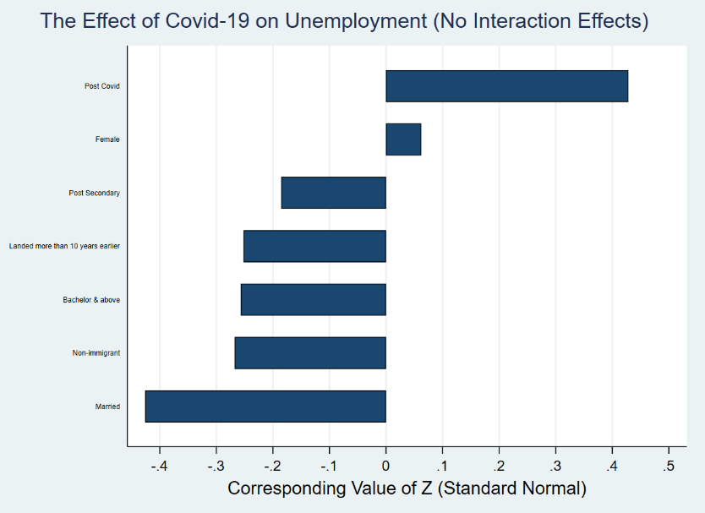
Unemployment
Notes:
The results also show that gender inequality still exists, as being a female increase the chance of being unemployed.
The disproportionate effect on females was likely due to increased childcare responsibility necessitated by the transition to virtual education.

Slide 7
Unemployment
Notes:
The results also show that gender inequality still exists, as being a female increase the chance of being unemployed.
The disproportionate effect on females was likely due to increased childcare responsibility necessitated by the transition to virtual education.

Slide 8
Unemployment
Notes:
The results also show that gender inequality still exists, as being a female increase the chance of being unemployed.
The disproportionate effect on females was likely due to increased childcare responsibility necessitated by the transition to virtual education.

Slide 9
Unemployment
Notes:
The results also show that gender inequality still exists, as being a female increase the chance of being unemployed.
The disproportionate effect on females was likely due to increased childcare responsibility necessitated by the transition to virtual education.

Slide 10
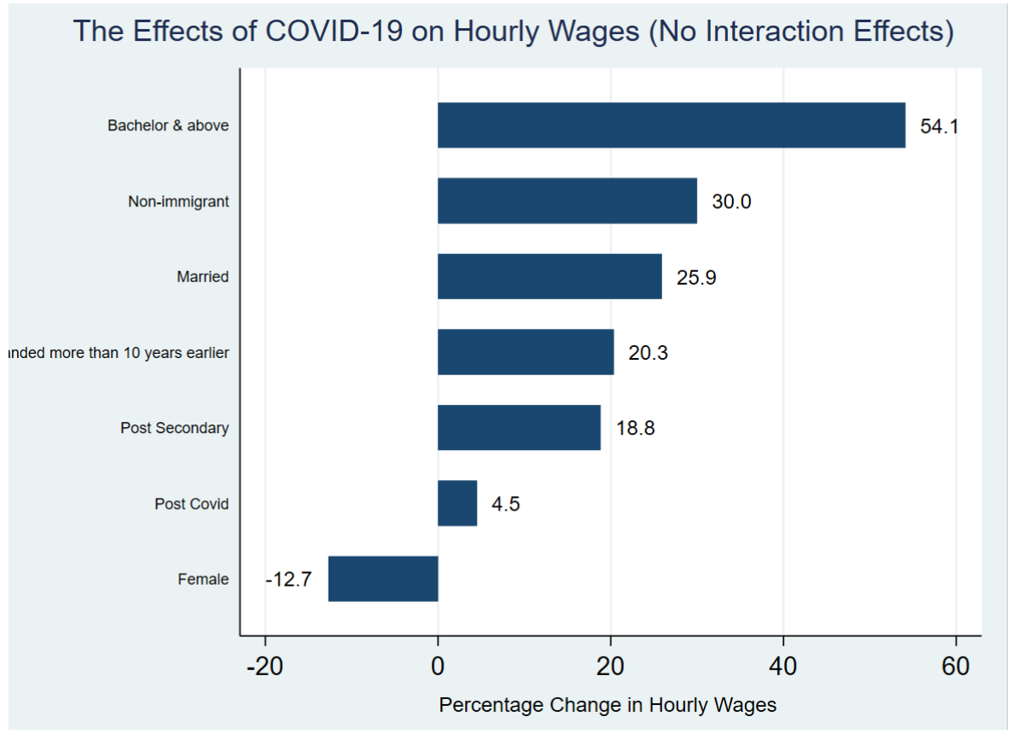
Wages
Notes:
Low-paying industries such as restaurants or hotels disproportionately suffered during the pandemic, leading to job losses. In contrast, workers in other sectors such as technology or education services, with well-paying jobs, benefited from a sharp increase in demand in the latter half of the year. A key trend noted is the discrimination between females and males in the labour market, with females receiving lower wages than their male counterparts – the wage disparity was close to 13%. Higher education positively affected hourly wage – wages of those with a postsecondary diploma or bachelor's degree were 18% and 54% higher than those with a high school diploma. As compared to immigrants who landed in Canada less than ten years ago, a person born in Canada or those who landed more than ten years benefited from a 30% and 20% higher salary, respectively. Likewise, being single negatively impacted hourly wages.

Slide 11
Wages
Notes:
Low-paying industries such as restaurants or hotels disproportionately suffered during the pandemic, leading to job losses. In contrast, workers in other sectors such as technology or education services, with well-paying jobs, benefited from a sharp increase in demand in the latter half of the year. A key trend noted is the discrimination between females and males in the labour market, with females receiving lower wages than their male counterparts – the wage disparity was close to 13%. Higher education positively affected hourly wage – wages of those with a postsecondary diploma or bachelor's degree were 18% and 54% higher than those with a high school diploma. As compared to immigrants who landed in Canada less than ten years ago, a person born in Canada or those who landed more than ten years benefited from a 30% and 20% higher salary, respectively. Likewise, being single negatively impacted hourly wages.

Slide 12
Wages
Notes:
Low-paying industries such as restaurants or hotels disproportionately suffered during the pandemic, leading to job losses. In contrast, workers in other sectors such as technology or education services, with well-paying jobs, benefited from a sharp increase in demand in the latter half of the year. A key trend noted is the discrimination between females and males in the labour market, with females receiving lower wages than their male counterparts – the wage disparity was close to 13%. Higher education positively affected hourly wage – wages of those with a postsecondary diploma or bachelor's degree were 18% and 54% higher than those with a high school diploma. As compared to immigrants who landed in Canada less than ten years ago, a person born in Canada or those who landed more than ten years benefited from a 30% and 20% higher salary, respectively. Likewise, being single negatively impacted hourly wages.

Slide 13
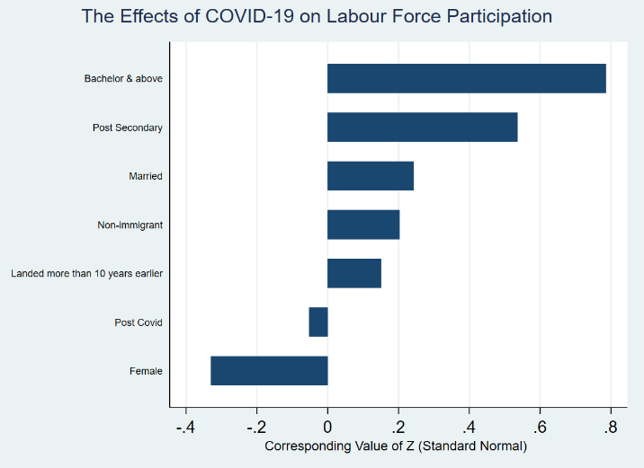
Labour force participation
Notes:
Labour force participation can be impacted considerably during economic crises arising from a pandemic. An individual who is actively looking for a job may leave the market due to not finding one. In addition to economic constraints, health considerations can also force job seekers to exit the labour market. As people risk getting infected by the virus, they may decide to leave the market until they feel safe. Also, the increased childcare responsibility owing to the transition to virtual schooling likely affected female participation along with the prevailing gender inequalities in pay structures. Consequently, we expect to see a negative relation between COVID-19 and labour force participation.
Source: https://www150.statcan.gc.ca/n1/daily-quotidien/200709/dq200709a-eng.htm

Slide 14
Labour force participation
Notes:
Labour force participation can be impacted considerably during economic crises arising from a pandemic. An individual who is actively looking for a job may leave the market due to not finding one. In addition to economic constraints, health considerations can also force job seekers to exit the labour market. As people risk getting infected by the virus, they may decide to leave the market until they feel safe. Also, the increased childcare responsibility owing to the transition to virtual schooling likely affected female participation along with the prevailing gender inequalities in pay structures. Consequently, we expect to see a negative relation between COVID-19 and labour force participation.
Source: https://www150.statcan.gc.ca/n1/daily-quotidien/200709/dq200709a-eng.htm

Slide 15
Labour force participation
Notes:
Labour force participation can be impacted considerably during economic crises arising from a pandemic. An individual who is actively looking for a job may leave the market due to not finding one. In addition to economic constraints, health considerations can also force job seekers to exit the labour market. As people risk getting infected by the virus, they may decide to leave the market until they feel safe. Also, the increased childcare responsibility owing to the transition to virtual schooling likely affected female participation along with the prevailing gender inequalities in pay structures. Consequently, we expect to see a negative relation between COVID-19 and labour force participation.
Source: https://www150.statcan.gc.ca/n1/daily-quotidien/200709/dq200709a-eng.htm

Slide 16
Labour force participation
Notes:
Labour force participation can be impacted considerably during economic crises arising from a pandemic. An individual who is actively looking for a job may leave the market due to not finding one. In addition to economic constraints, health considerations can also force job seekers to exit the labour market. As people risk getting infected by the virus, they may decide to leave the market until they feel safe. Also, the increased childcare responsibility owing to the transition to virtual schooling likely affected female participation along with the prevailing gender inequalities in pay structures. Consequently, we expect to see a negative relation between COVID-19 and labour force participation.
Source: https://www150.statcan.gc.ca/n1/daily-quotidien/200709/dq200709a-eng.htm

Slide 17
Sectoral Analysis: What are the organizational and industrial changes occurring and expected in the years to come?

Slide 18
Sector Analysis
 | 2016-17 | 2017-18 | 2018-19 | 2019-20 | Months of negative change | Category | Negative IRF periods (quarters) | Is the impulse persistent?
 | (1) | (2) | (3) | (4) | (5) | (6) | (7) | (8)
Accommodation and food services | 14% | -8% | -9% | -31% | 12 | Emergency | 5 | No
Manufacturing | -8% | 9% | -8% | -10% | 8 | Emergency | 9 | No
Retail trade | 4% | 7% | -8% | -6% | 5 | Must be monitored | 8 | No
Transportation and warehousing | 20% | 14% | 16% | -19% | 4 | Must be monitored | 3 | No
Health care and social assistance | -1% | -0.4% | 11% | -8% | 4 | Must be monitored | N/A | No
Construction | -1% | -3% | 8% | -8% | 3 | Must be monitored | 5 | No
Educational services | -8% | 10% | 13% | -9% | 3 | Must be monitored | 5 | No
Finance, insurance, real estate and leasing | -4% | -7% | 7% | 2% | 1 | Stable | 5 | No
Professional, scientific and technical services | 5% | 4% | 2% | 1% | 1 | Stable | 5 | No
Notes:
(1) Columns 1 to 4 depict the annual year-over-year change in employment.
(2) Column 5 depicts the number of months of negative employment change in 2020.
(3) Column 6 depicts the category where the sector falls using the criteria listed in Table 1.
(4) Column 7 depicts the number of negative quarters of response to the COVID-19 shock starting after the first quarter of 2021, using the Impulse Response Functions (IRF). Note due to lack of data, IRF were not estimated for the Healthcare and Social Assistance sector. Also, provincial data was used to estimate the IRFs.
(5) Column 8 indicates if the response from the COVID-19 was persistent (remained negative) over the ten quarters starting from the first quarter of 2021.
Notes:
Table 1: Sector Classification criteria
Category
Criteria
Emergency: Negative change in the year over year employment levels (2020-2019) & 8 or more negative monthly year over year (2020-2019) decline in employment
Must be monitored: Negative change in the year over year employment levels (2020-2019) & 3-8 negative monthly year over year (2020-2019) change in employment
Stable: Positive change in the year over year employment levels (2020-2019)

Slide 19
Sector Analysis
 | 2016-17 | 2017-18 | 2018-19 | 2019-20 | Months of negative change | Category | Negative IRF periods (quarters) | Is the impulse persistent?
 | (1) | (2) | (3) | (4) | (5) | (6) | (7) | (8)
Accommodation and food services | 14% | -8% | -9% | -31% | 12 | Emergency | 5 | No
Manufacturing | -8% | 9% | -8% | -10% | 8 | Emergency | 9 | No
Retail trade | 4% | 7% | -8% | -6% | 5 | Must be monitored | 8 | No
Transportation and warehousing | 20% | 14% | 16% | -19% | 4 | Must be monitored | 3 | No
Health care and social assistance | -1% | -0.4% | 11% | -8% | 4 | Must be monitored | N/A | No
Construction | -1% | -3% | 8% | -8% | 3 | Must be monitored | 5 | No
Educational services | -8% | 10% | 13% | -9% | 3 | Must be monitored | 5 | No
Finance, insurance, real estate and leasing | -4% | -7% | 7% | 2% | 1 | Stable | 5 | No
Professional, scientific and technical services | 5% | 4% | 2% | 1% | 1 | Stable | 5 | No
Notes:
(1) Columns 1 to 4 depict the annual year-over-year change in employment.
(2) Column 5 depicts the number of months of negative employment change in 2020.
(3) Column 6 depicts the category where the sector falls using the criteria listed in Table 1.
(4) Column 7 depicts the number of negative quarters of response to the COVID-19 shock starting after the first quarter of 2021, using the Impulse Response Functions (IRF). Note due to lack of data, IRF were not estimated for the Healthcare and Social Assistance sector. Also, provincial data was used to estimate the IRFs.
(5) Column 8 indicates if the response from the COVID-19 was persistent (remained negative) over the ten quarters starting from the first quarter of 2021.

Slide 20
Sector Analysis
 | 2016-17 | 2017-18 | 2018-19 | 2019-20 | Months of negative change | Category | Negative IRF periods (quarters) | Is the impulse persistent?
 | (1) | (2) | (3) | (4) | (5) | (6) | (7) | (8)
Accommodation and food services | 14% | -8% | -9% | -31% | 12 | Emergency | 5 | No
Manufacturing | -8% | 9% | -8% | -10% | 8 | Emergency | 9 | No
Retail trade | 4% | 7% | -8% | -6% | 5 | Must be monitored | 8 | No
Transportation and warehousing | 20% | 14% | 16% | -19% | 4 | Must be monitored | 3 | No
Health care and social assistance | -1% | -0.4% | 11% | -8% | 4 | Must be monitored | N/A | No
Construction | -1% | -3% | 8% | -8% | 3 | Must be monitored | 5 | No
Educational services | -8% | 10% | 13% | -9% | 3 | Must be monitored | 5 | No
Finance, insurance, real estate and leasing | -4% | -7% | 7% | 2% | 1 | Stable | 5 | No
Professional, scientific and technical services | 5% | 4% | 2% | 1% | 1 | Stable | 5 | No
Notes:
(1) Columns 1 to 4 depict the annual year-over-year change in employment.
(2) Column 5 depicts the number of months of negative employment change in 2020.
(3) Column 6 depicts the category where the sector falls using the criteria listed in Table 1.
(4) Column 7 depicts the number of negative quarters of response to the COVID-19 shock starting after the first quarter of 2021, using the Impulse Response Functions (IRF). Note due to lack of data, IRF were not estimated for the Healthcare and Social Assistance sector. Also, provincial data was used to estimate the IRFs.
(5) Column 8 indicates if the response from the COVID-19 was persistent (remained negative) over the ten quarters starting from the first quarter of 2021.

Slide 21
Sector Analysis
 | 2016-17 | 2017-18 | 2018-19 | 2019-20 | Months of negative change | Category | Negative IRF periods (quarters) | Is the impulse persistent?
 | (1) | (2) | (3) | (4) | (5) | (6) | (7) | (8)
Accommodation and food services | 14% | -8% | -9% | -31% | 12 | Emergency | 5 | No
Manufacturing | -8% | 9% | -8% | -10% | 8 | Emergency | 9 | No
Retail trade | 4% | 7% | -8% | -6% | 5 | Must be monitored | 8 | No
Transportation and warehousing | 20% | 14% | 16% | -19% | 4 | Must be monitored | 3 | No
Health care and social assistance | -1% | -0.4% | 11% | -8% | 4 | Must be monitored | N/A | No
Construction | -1% | -3% | 8% | -8% | 3 | Must be monitored | 5 | No
Educational services | -8% | 10% | 13% | -9% | 3 | Must be monitored | 5 | No
Finance, insurance, real estate and leasing | -4% | -7% | 7% | 2% | 1 | Stable | 5 | No
Professional, scientific and technical services | 5% | 4% | 2% | 1% | 1 | Stable | 5 | No
Notes:
(1) Columns 1 to 4 depict the annual year-over-year change in employment.
(2) Column 5 depicts the number of months of negative employment change in 2020.
(3) Column 6 depicts the category where the sector falls using the criteria listed in Table 1.
(4) Column 7 depicts the number of negative quarters of response to the COVID-19 shock starting after the first quarter of 2021, using the Impulse Response Functions (IRF). Note due to lack of data, IRF were not estimated for the Healthcare and Social Assistance sector. Also, provincial data was used to estimate the IRFs.
(5) Column 8 indicates if the response from the COVID-19 was persistent (remained negative) over the ten quarters starting from the first quarter of 2021.

Slide 22
Sector Analysis
 | 2016-17 | 2017-18 | 2018-19 | 2019-20 | Months of negative change | Category | Negative IRF periods (quarters) | Is the impulse persistent?
 | (1) | (2) | (3) | (4) | (5) | (6) | (7) | (8)
Accommodation and food services | 14% | -8% | -9% | -31% | 12 | Emergency | 5 | No
Manufacturing | -8% | 9% | -8% | -10% | 8 | Emergency | 9 | No
Retail trade | 4% | 7% | -8% | -6% | 5 | Must be monitored | 8 | No
Transportation and warehousing | 20% | 14% | 16% | -19% | 4 | Must be monitored | 3 | No
Health care and social assistance | -1% | -0.4% | 11% | -8% | 4 | Must be monitored | N/A | No
Construction | -1% | -3% | 8% | -8% | 3 | Must be monitored | 5 | No
Educational services | -8% | 10% | 13% | -9% | 3 | Must be monitored | 5 | No
Finance, insurance, real estate and leasing | -4% | -7% | 7% | 2% | 1 | Stable | 5 | No
Professional, scientific and technical services | 5% | 4% | 2% | 1% | 1 | Stable | 5 | No
Notes:
(1) Columns 1 to 4 depict the annual year-over-year change in employment.
(2) Column 5 depicts the number of months of negative employment change in 2020.
(3) Column 6 depicts the category where the sector falls using the criteria listed in Table 1.
(4) Column 7 depicts the number of negative quarters of response to the COVID-19 shock starting after the first quarter of 2021, using the Impulse Response Functions (IRF). Note due to lack of data, IRF were not estimated for the Healthcare and Social Assistance sector. Also, provincial data was used to estimate the IRFs.
(5) Column 8 indicates if the response from the COVID-19 was persistent (remained negative) over the ten quarters starting from the first quarter of 2021.

Slide 23
Sector Analysis
 | 2016-17 | 2017-18 | 2018-19 | 2019-20 | Months of negative change | Category | Negative IRF periods (quarters) | Is the impulse persistent?
 | (1) | (2) | (3) | (4) | (5) | (6) | (7) | (8)
Accommodation and food services | 14% | -8% | -9% | -31% | 12 | Emergency | 5 | No
Manufacturing | -8% | 9% | -8% | -10% | 8 | Emergency | 9 | No
Retail trade | 4% | 7% | -8% | -6% | 5 | Must be monitored | 8 | No
Transportation and warehousing | 20% | 14% | 16% | -19% | 4 | Must be monitored | 3 | No
Health care and social assistance | -1% | -0.4% | 11% | -8% | 4 | Must be monitored | N/A | No
Construction | -1% | -3% | 8% | -8% | 3 | Must be monitored | 5 | No
Educational services | -8% | 10% | 13% | -9% | 3 | Must be monitored | 5 | No
Finance, insurance, real estate and leasing | -4% | -7% | 7% | 2% | 1 | Stable | 5 | No
Professional, scientific and technical services | 5% | 4% | 2% | 1% | 1 | Stable | 5 | No
Notes:
(1) Columns 1 to 4 depict the annual year-over-year change in employment.
(2) Column 5 depicts the number of months of negative employment change in 2020.
(3) Column 6 depicts the category where the sector falls using the criteria listed in Table 1.
(4) Column 7 depicts the number of negative quarters of response to the COVID-19 shock starting after the first quarter of 2021, using the Impulse Response Functions (IRF). Note due to lack of data, IRF were not estimated for the Healthcare and Social Assistance sector. Also, provincial data was used to estimate the IRFs.
(5) Column 8 indicates if the response from the COVID-19 was persistent (remained negative) over the ten quarters starting from the first quarter of 2021.

Slide 24
Sector Analysis
 | 2016-17 | 2017-18 | 2018-19 | 2019-20 | Months of negative change | Category | Negative IRF periods (quarters) | Is the impulse persistent?
 | (1) | (2) | (3) | (4) | (5) | (6) | (7) | (8)
Accommodation and food services | 14% | -8% | -9% | -31% | 12 | Emergency | 5 | No
Manufacturing | -8% | 9% | -8% | -10% | 8 | Emergency | 9 | No
Retail trade | 4% | 7% | -8% | -6% | 5 | Must be monitored | 8 | No
Transportation and warehousing | 20% | 14% | 16% | -19% | 4 | Must be monitored | 3 | No
Health care and social assistance | -1% | -0.4% | 11% | -8% | 4 | Must be monitored | N/A | No
Construction | -1% | -3% | 8% | -8% | 3 | Must be monitored | 5 | No
Educational services | -8% | 10% | 13% | -9% | 3 | Must be monitored | 5 | No
Finance, insurance, real estate and leasing | -4% | -7% | 7% | 2% | 1 | Stable | 5 | No
Professional, scientific and technical services | 5% | 4% | 2% | 1% | 1 | Stable | 5 | No
Notes:
(1) Columns 1 to 4 depict the annual year-over-year change in employment.
(2) Column 5 depicts the number of months of negative employment change in 2020.
(3) Column 6 depicts the category where the sector falls using the criteria listed in Table 1.
(4) Column 7 depicts the number of negative quarters of response to the COVID-19 shock starting after the first quarter of 2021, using the Impulse Response Functions (IRF). Note due to lack of data, IRF were not estimated for the Healthcare and Social Assistance sector. Also, provincial data was used to estimate the IRFs.
(5) Column 8 indicates if the response from the COVID-19 was persistent (remained negative) over the ten quarters starting from the first quarter of 2021.

Slide 25
Sector Analysis
 | 2016-17 | 2017-18 | 2018-19 | 2019-20 | Months of negative change | Category | Negative IRF periods (quarters) | Is the impulse persistent?
 | (1) | (2) | (3) | (4) | (5) | (6) | (7) | (8)
Accommodation and food services | 14% | -8% | -9% | -31% | 12 | Emergency | 5 | No
Manufacturing | -8% | 9% | -8% | -10% | 8 | Emergency | 9 | No
Retail trade | 4% | 7% | -8% | -6% | 5 | Must be monitored | 8 | No
Transportation and warehousing | 20% | 14% | 16% | -19% | 4 | Must be monitored | 3 | No
Health care and social assistance | -1% | -0.4% | 11% | -8% | 4 | Must be monitored | N/A | No
Construction | -1% | -3% | 8% | -8% | 3 | Must be monitored | 5 | No
Educational services | -8% | 10% | 13% | -9% | 3 | Must be monitored | 5 | No
Finance, insurance, real estate and leasing | -4% | -7% | 7% | 2% | 1 | Stable | 5 | No
Professional, scientific and technical services | 5% | 4% | 2% | 1% | 1 | Stable | 5 | No
Notes:
(1) Columns 1 to 4 depict the annual year-over-year change in employment.
(2) Column 5 depicts the number of months of negative employment change in 2020.
(3) Column 6 depicts the category where the sector falls using the criteria listed in Table 1.
(4) Column 7 depicts the number of negative quarters of response to the COVID-19 shock starting after the first quarter of 2021, using the Impulse Response Functions (IRF). Note due to lack of data, IRF were not estimated for the Healthcare and Social Assistance sector. Also, provincial data was used to estimate the IRFs.
(5) Column 8 indicates if the response from the COVID-19 was persistent (remained negative) over the ten quarters starting from the first quarter of 2021.

Slide 26
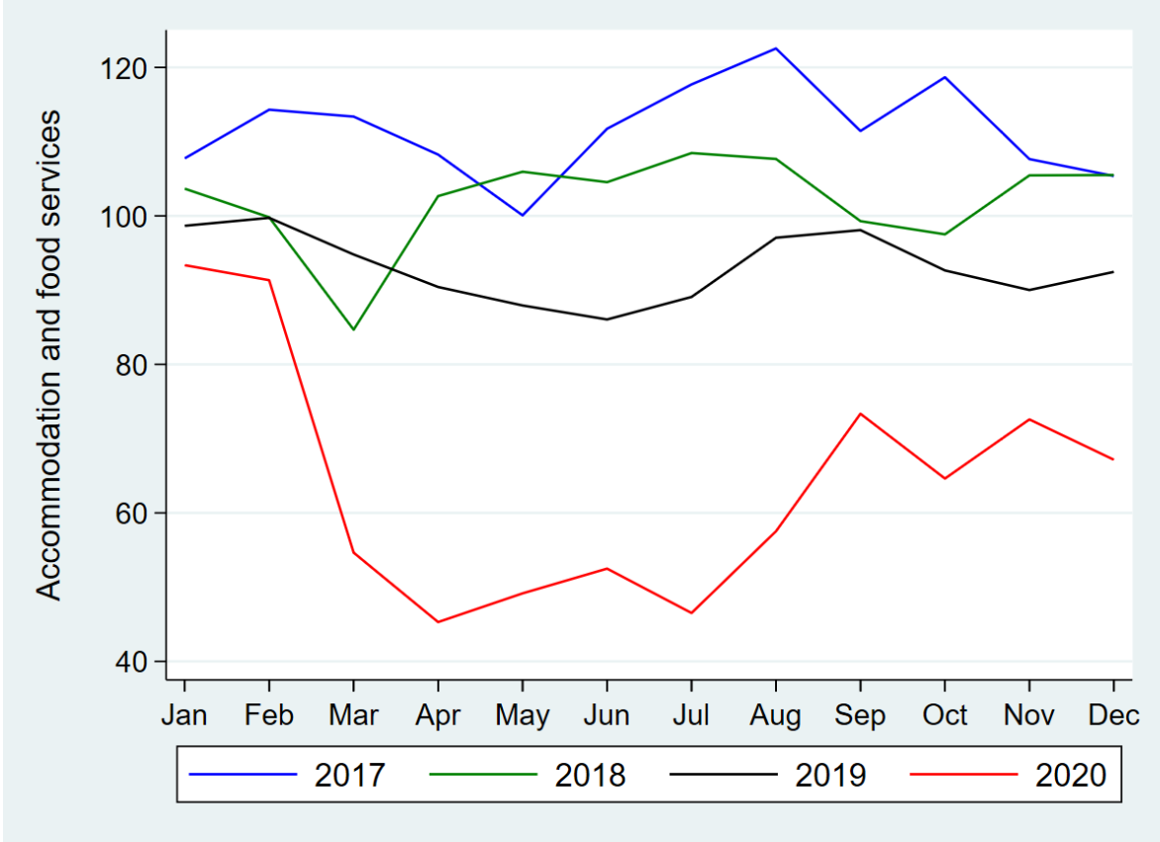
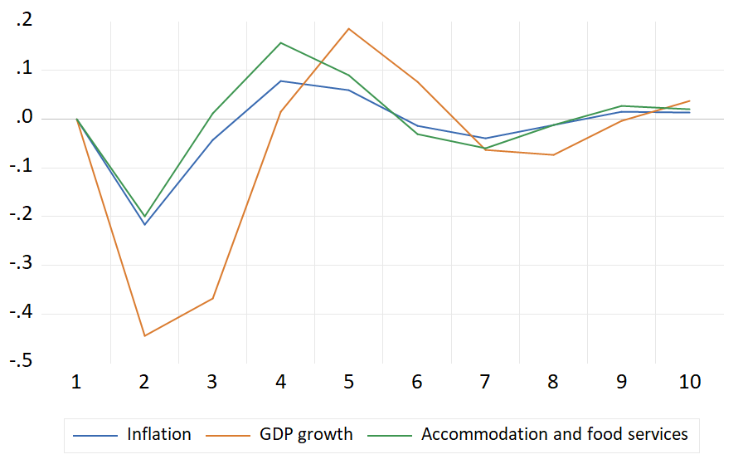
Accommodation and food services
Employees less educated, youth with 62% between the ages of 15-24 and working part-time
Average hourly wage $17.07, lowest among all major sectors
Automation of service-oriented positions like order-takers and cashiers
More businesses closing than opening also depict sectoral weakness - net loss of 1327 businesses
Employment declined by 31% in 2020 (349,000 jobs compared to the previous year - the largest drop among all major sectors in Toronto
The effect (response) of the shock (COVID-19) starting in 2021 is negative for the first two quarters and does not entirely dissipate until the ninth quarter.

Slide 27
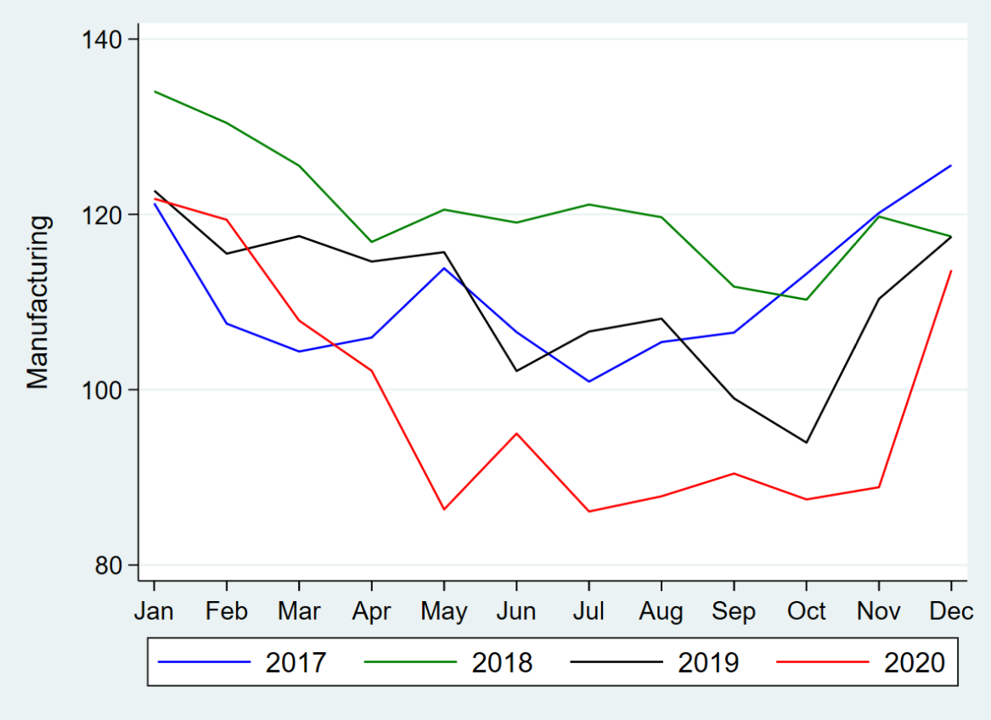
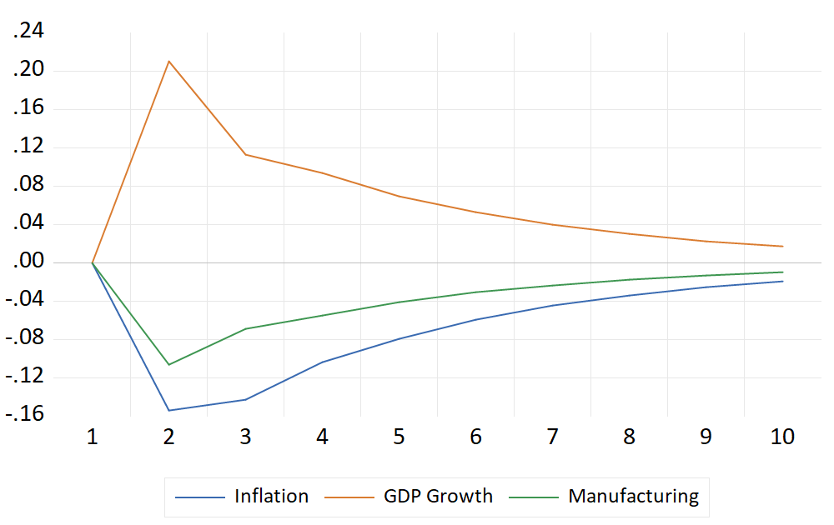
Manufacturing
The trends in manufacturing for 2020 are closely related to the shutdowns in spring and early summer
Four-fifths of manufacturers reported a negative impact on their operations – manufacturing of retail goods ↓
Sector accounted for 7% of total employment in 2020, down from 8% in the previous year
The inability of most of the jobs in this sector to transition to remote work hampered the employment market – only 10% of the workforce could transition to remote work
The IRF forecast shows that the negative impact on employment is expected to continue for at least the next ten quarters
The employment in this sector fell to a low of 86,100 in July with a slight rebound in the subsequent months due to the economy's reopening

Slide 28
Industrial Transformation
Pandemic → inefficiencies and structural problems.
40% of Canadians jobs → lack of flexibility for remote work → a rapid transition spared the worst outcome for labour market Deng et al. (2020)
Disproportionate impact on smaller businesses compared to large corporations (Barrero et al.2020) → over March-May 2020, for every 10 layoffs in America due to COVID-19, mega-corporations hired between 3-4 new workers.
Remote work → jobs with relatively high education and high remuneration → little productivity loss
Longer-term planning for structural and permanent changes to workforce management.
Industrial 4.0 / Industrial Transformation → full automation, rapid AI and robotics

Slide 29
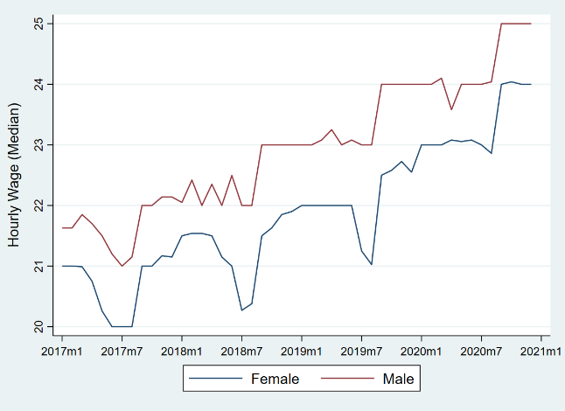
Key Risks
Disproportionate impact – females and immigrant workers lost significantly more jobs due to the damage caused by the pandemic than any other group.
Increase adoption of technology in industry → further challenges in the job market
Labour market shortages
Inflationary pressures
Housing market
The wage gap continues

Slide 30
Recommendations
Address gender wage gap along with widening income inequality
Retraining programs for the most vulnerable segment of the population to prepare for the technology-oriented jobs of the future.
Targeted assistance to ailing sectors – accommodation & food / manufacturing
Targeted funding programs to meet the need for automation and technology related employment in particular due to the surge in AI/Robotics/Big Data.
Retraining and job readiness programs (universal income?) to deal with the redundancy in organizations created by the increased use of technology.

Slide 31
The End
Thank-you!

Slide 32
Model Formulation – Labour Market Outcomes
Probit Model: $Y_{it}=α_{i}+θ_{month}+τ_{year}+ρ_{1}{COV}_{it}+\sum_{j=1}^{4}{ρ_{j}X_{ijt}}+\sum_{j=1}^{4}{λ_{j}{{(COV}_{it}×X}_{ijt})}+ε_{it}$
$Y$ $\left\{\begin{aligned}1=if employed \\ 0=if not employed\end{aligned}\right.$
$θ_{month}$ and $τ_{year}$ denote time fixed effects for different months and years, respectively.
$COV$ is a binary variable which equals one if the observation occurs during or after April 2020
binary variable $X$₁ = 1 if an individual is a female and 0 otherwise
categorical variable $X$₂ = 1 if an individual has some postsecondary certificate or diploma, 2 if she has a bachelor’s degree or above and 0 otherwise
categorical variable $X$₃ = 0 if the observation landed 10 years earlier or less, 1 for an individual who landed more than 10 years earlier, and 2 for an observer born in Canada
dummy variable $X$₄ =1if if married or common law

Slide 33
Model Formulation – Labour Market Outcomes
6 models for assessing our model's robustness.
Model 1: estimate the effect of COVID-19 on unemployment without considering any interaction effects.
Models 2 to 5: interactive effect between COVID-19 and one of the independent variables was considered.
Model 6: the simultaneous effects of COVID-19 on all other regressors are included.
Data: Canadian Labour Force Survey (CLFS)

